Slide 1



PRE-GRADUATION SAFETY TIPS
Corporal Vincent Chan, Montgomery County Police Department
Paul Chung, Esq., Shulman Rogers

Slide 2
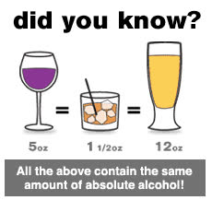
AVERAGE BREATH ALCOHOL CONTENT FOR MONTGOMERY COUNTY, MD
FATAL COLLISION DATA
  Over 21 years old- 0.17 BAC
  Under 21 years old- 0.24 BAC
SUBURBAN HOSPITAL DATA
  On average, three juveniles per week are transported to the hospital with an average BAC 0.30 +

Slide 3


MARYLAND DUI/DWI LAWS
WHAT IS YOUR DEFINITION OF “DRIVING”
Driving, operating, moving, or being in actual physical control of a vehicle, including the exercise of control over or the steering of a vehicle being towed by a motor vehicle
PRIMA FACIE EVIDENCE OF ALCOHOL IN THE SYSTEM
A BAC of 0.02 or higher will be prima facie evidence that the driver was operating with alcohol in his her her system
DRIVING WHILE IMPAIRED BY ALCOHOL
A person may not drive a vehicle while impaired by alcohol (A BAC of .07 or higher but less
than .08 –the presumption that the driver was impaired by alcohol)
PENALTIES:
60 days / $500
DRIVING UNDER THE INFLUENCE OF ALCOHOL
A person may not drive a vehicle while under the influence of alcohol (BAC .08 or higher)
PENALTIES:
1 year/ $1000

Slide 4
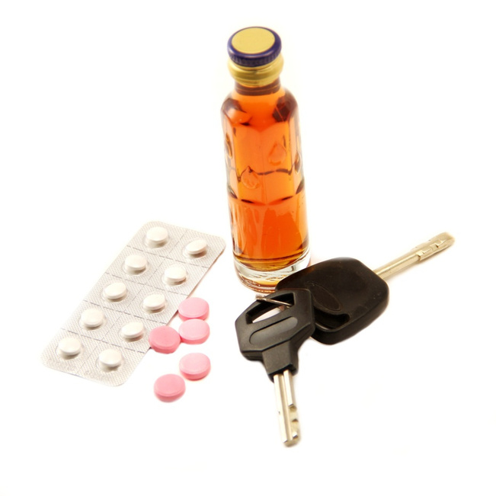
DRIVING UNDER THE INFLUENCE
DRUG/ALCOHOL COMBINATION
A person may not drive while under the influence of any drug or combination of drugs and alcohol.
  Includes Rx medication
  Includes over –the-counter medications
PENALTIES:
60 days / $500

Slide 5
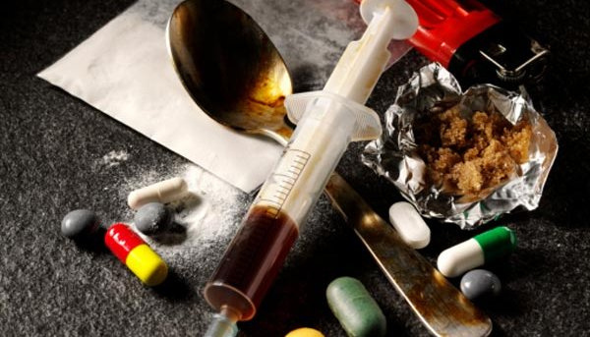
DRIVING WHILE UNDER THE INFLUENCE OF DRUGS
A person may not drive while under the influence of any controlled dangerous substances.
PENALTIES:
1 year / $1000

Slide 6
COST OF A DUI
  Lawyer Fees
  Court Cost to include MVA Fees
  Alcohol Education Programs
  Interlock System and Rental
  Probation Fees
  Insurance Rate Increases
  $1500 increase each year for 3 years
  Potential Civil Liability

Slide 7

UNDERAGE DRINKING PARTIES

Slide 8
PENALTIES FOR DRINKING UNDERAGE
Possession of Alcohol - Under 21 Years
Legal Statute
Typical Plea Offer
Person under the age of 21 years in possession of an alcoholic beverage
PENALTIES: (Maximum) $500 / $1,000
Possession- Knowledge of alcohol being present (aka-”constructive possession”)
PENALTIES :
  First Offense – SASCA* Evaluation
  Second Offense – SASCA* and Teen Court
  Third Offense – Department of Juvenile Services
*Screening and Assessment Services for Children and Adolescents

Slide 9
FURNISHING ALCOHOL TO PERSONS UNDER 21
ALEX AND CALVIN’S LAW
Alex and Calvin's Law, which applies to adults who knowingly allow underage drinking in their homes, allows courts to impose not only a fine of up to $2,500 per offense, but also jail time.
Legal Statute
Typical Plea Offer
  Person allowing person(s) under 21 years of age to possess alcohol
  PENALTIES: $2,500.00 / $5,000
Dependent on circumstances
  Community Service
  Parenting Classes
  Monetary Fine
  Probation

Slide 10
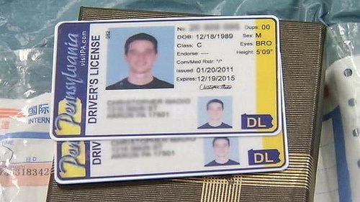
POSSESSION OF FALSE IDENTIFICATION
An individual under the age of 21 years may not possess a card or document that falsely identifies the age of the individual under circumstances that reasonably indicate an intention to violate the provisions of this section.
PENALTIES: $500/$1000
Note: Criminal Charge is available under “Possess/Use False Government Identification Document”

Slide 11
POSSESSION OF MARIJUANA CHARGES
As of July 1, 2023, possession and use of small amounts of cannabis and cannabis products will be legal for individuals at least 21 years old. Possession and use by individuals younger than age 21 is illegal and subject to civil penalties.
A person under 21 years of age may not possess or use non-medical cannabis. Possession of 2.5 ounces or less (a civil use amount) may result in a fine, a court order to attend drug education programming, and referral for assessment and/or treatment of substance use disorder. Possession of more than 2.5 ounces may result in criminal penalties.

Slide 12
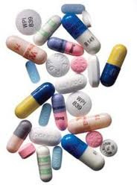
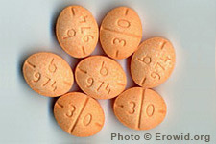
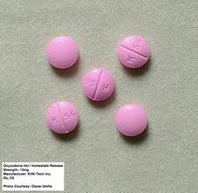
VAPES & PRESCRIPTION DRUG ABUSE
  SPECIAL REMINDER: VAPES - In Maryland, the sale and distribution of electronic smoking devices to minors under the age of 21 is prohibited
  Adderall
  Oxycodone
  Ambien
  Anti-depressants

Slide 13
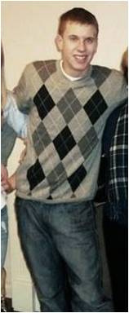
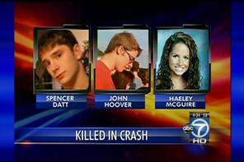
KEVIN COFFAY
May 15th, 2011 - Olney, MD
  Magruder student who killed three of his friends
  BAC was a 0.16 (3 hours after the accident)
  Fled the scene of the accident
  Initial sentence was 40 years

Slide 14
Reactions from Families
"My heart is broken.“
“I can only feel rage and despair. He has taken everything from me.“
"Kevin Coffay is an irresponsible coward who left my sister to die in the wreckage at the side of the road."

Slide 15
QUESTIONS?

Slide 16

Paul Chung, Esq.
THANK YOU
Paul Chung, Esq.
Shulman Rogers
301-230-5230
pchung@shulmanrogers.com
Corporal Vincent Chan
MCPD
301-279-8000 (non-emergency line)

